Slide 1
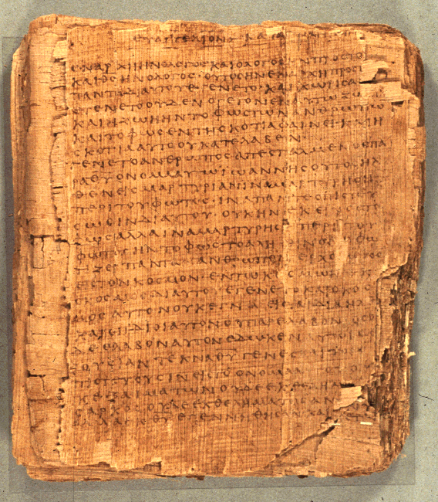
Comprehending the Psalms
Dr. Rodney K. Duke

Slide 2
CLASS 3
Assign: [Focus on #3 and #5, #4 is a reading]
Daily Journal
Assign. #3. Formulate a tentative reading strategy
Assign. #4. Learn about the purity and holiness systems.
Assign. #5. Develop skill of identifying and outlining the 3 basic types of psalms.
Day Objectives:
Explain the cultic symbol system behind the sacrificial system.
Learn to identify and outline the 3 basic psalm types.

Slide 3
Define “Cult”/“Cultic”
Any tangible expressions of religion (rituals, gestures, places, objects, personnel, seasons, etc.)

Slide 4
Today Ancient Israel
Rituals
Gestures
Places
Objects
Personnel
Seasons

Slide 5
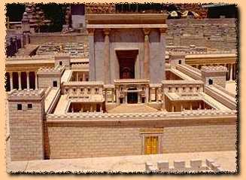
Overview
Setting of transmission and employment
1. Whatever the origin of the Psalms, they seem to have been used
in the Temple worship as collected “books” of psalms.
2. The Psalms as we have them have been made very generic:
enemies, illnesses, threats, occasions of joy, etc. are stated in
general terms.
3. As a result, the Psalms have become applicable to all people.

Slide 6
Hymnic Literature
H. Gunkel
#2. Obj.: Discover the formal element of different kinds of psalms.
Compare and contrast Psalms 33, 34, 74, 79, 113, and 116. (Consider: rhetorical intention; addressee; themes; mood and mood shifts; whether the speaker is reflecting on the past, present, or future; etc.)
Match up the psalms which are most alike, forming three sets of pairs.
What are the elements which are similar between the two psalms in each of your pairings?
What elements distinguish each set from the other sets of your pairs?

Slide 7
PAIRINGS
Pss 74, 79:
Pss 34, 116
Pss 33, 113

Slide 8
Overview
Creating a “Reading Strategy” for Psalms
1. Because of the generic nature of the Psalms, we are learning to
read them “form critically,” that is, according to their use
within a social setting. [Contribution of Hermann Gunkel]
A. The social setting of the temple sheds light on the
function of the psalms, and
B. The forms of the psalms sheds light on the social setting
(the faith and practices) of the Israelites.
2. 3 major forms found in the 150 psalms [two naming systems]
Psalms of Petition / Psalms of Lament
Psalms of Declarative Praise / Psalms of Thanksgiving
Psalms of Descriptive Praise / Hymns

Slide 9
OUTLINING PSALM TYPES
(See Handouts, pp. 18-23)
Two main naming systems:
Psalms of Petition / Psalms of Lament
Psalms of Declarative Praise / Psalms of Thanksgiving
Psalms of Descriptive Praise / Hymns

Slide 10
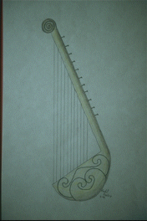
Psalms of Lament/Petition (1 of 3)
General characteristics: personal, speaker primarily addresses God, mood shifts from to despair to some hope/trust, oriented in the present setting of need or crisis
(What rhetorical difference does music make?)
I. Motifs Found in Lament Psalms (no set order)
A. Often: Introductory petition/lament
(e.g. Save me, because people persecute me.)
B. Lament [Types: 1) claim innocence,
2) plea for forgiveness]
(Often from different perspectives)
1) You (God) are …
2) I am …
3) They (foes) are …
Drawing of a Lyre. Copyright Zondervan Image Archives

Slide 11
Psalms of Lament/Petition (2 of 3)
C. Petition to God
1) To take favorable notice
2) To intervene
3) Motivation
4) “Double wish”
a) against enemies (imprecation)
b) for oneself
[honest how they feel and bold]

Slide 12
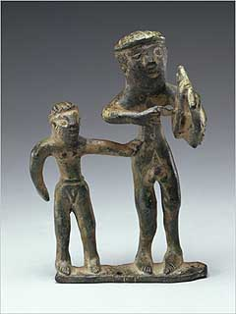
Psalms of Lament/Petition (3 of 3)
D. Confession of Trust
(Hebrew waw adversative) Look for words
such as then” “now” “but” and a shift to a
positive mood.
1. Specific trust elements:
a) vow of praise (more in individual
laments than in communal)
b) declarative praise
Statuette of Lyre Player. Copyright: http://www.getty.edu/museum/objects/Antiquities/90_AB_6_A.htm

Slide 13
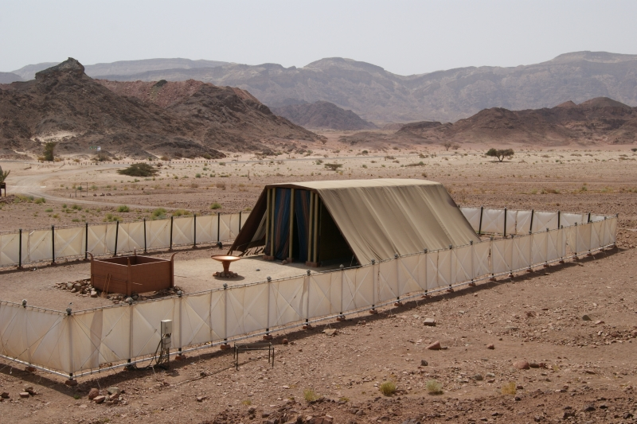
Communal Lament
‘Answer’ by God = prophetic role of priest with oracle of salvation?
Ps. 85:8
Ps. 12:5
Ps. 91:14-15
Ps. 21:8?
See 1 Samuel 1:17

Slide 14
Psalms of Declarative Praise (Thanksgiving)
(1 of 2)
General
Personal, use of 1st person
Mood: consistent, joyful
Audience: usually switches between God and community
Time: in the present, the psalmist looks back to the past
Setting: celebration of todah offering with extended family and the poor
I. Motifs and Structure
A. Opening Proclamation
1. States intention to praise God (“You”)
and/or 2. (Introductory Summary)

Slide 15
Psalms of Declarative Praise (Thanksgiving)
(2 of 2)
B. Report of Deliverance
1. Trial or problem
2. Psalmists cry to God - “I cried,” “He heard”
3. The deliverance - “He delivered”
C. Conclusion
1. Renewed vow of praise
(2. Descriptive praise
(3. Instruction
May be woven into the “Report”

Slide 16
Psalms of Descriptive Praise (Hymns)
C. Conclusion: many options
1. Renewed call to praise
2. Exhortations
3. Petition, etc.
4. Vow of praise
(Epilogue: Hallelujah)
any

Slide 17
Psalm 113
(abbreviated outline)
I. Call to Praise, 1-3
A. Whom: Yahweh; By whom: servants; Whom, 1 (3-fold rep.)
B. Whom: Yahweh; When and Where, 2-3 [note chiasm]
1. Praise name of Yahweh
2. From now to the end [merism = always]
3. From place sun rises to sets [= everywhere]
4. Praise name of Yahweh
ABBA
II. Cause for Praise, 4-9b
A. Yahweh is over all (sovereign), 4-6
B. Yahweh Intervenes (gracious), 7-9b
III. Concluding Call to Praise, 9c

Slide 18
BACKGROUND ON PSALMS
Theological Basis and/or Implications
Each psalm has own distinct message; but some generalizations:
A. Petitions:
1. God is to be approached boldly, with complete openness
2. Even in despair, the psalmist expressed trust
B. Thanksgivings:
1. God is to be thanked by testimony before the community
in celebration
2. God is experientially knowable
3. Faith in God who acts on their behalf
C. Hymns:
1. God is worthy of praise
2. God, who is majestic and sovereign, graciously
condescends to care for those who trust God

